Slide 1
Text Classification using IMDB Dataset

Slide 2
Problem Statement
The challenge is to classify sentiment ( either positive or negative) of IMDB movie reviews. And understand whether the movie is perceived to be good or bad.
Sentiment analysis is widely applied to voice of the customer materials such as reviews, social media, and healthcare materials for applications that range from marketing to customer service to clinical medicine.
This challenge is presented as a text classification problem where we implement three different architectures.
Convolutional Neural Network
Recurrent Neural Network
Hierarchical Attention Network

Slide 3
About IMDB Dataset
The dataset contains a total of 50,000 movie reviews equally split in training and testing dataset.
Each set (train and test) has 12500 positive label and 12500 negative label.
The reviewers on IMDB reviewed each movie and rated on a scale of 1-10. All the movie reviews which scored >= 7 were treated as positive and movie reviews which scored <= 4 were treated as negative. The movies with score of 5 and 6 were ignored.
This data was compiled by Andrew Maas and can be found here: https://ai.stanford.edu/~amaas/data/sentiment/

Slide 4
Word Embeddings and Usage
Word embeddings are numeric vector representations of word. For the purpose of this project, we have used GloVe word embeddings.
GloVe is an unsupervised learning algorithm for obtaining vector representations for words.
These pre-trained word embeddings are available at the following link
https://nlp.stanford.edu/projects/glove/
There are multiple flavours of pretrained GloVe word vectors available.For our implementation, we have used 300 dimensional word vectors trained on Common Crawl data (840B tokens, 2.2M vocab, cased).

Slide 5
Data Preparation
The original reviews are stored in text files. Positive and negative reviews are stored in different folders. We extract the texts from the files and insert them into lists for further preprocessing of the texts.
Preprocessing steps include:
Labelling the positive texts with 1 and negative texts with 0
Removing punctuation and special characters
Splitting and tokenizing text.
Creating word to unique word index map
Replacing words with unique word indices.

Slide 6
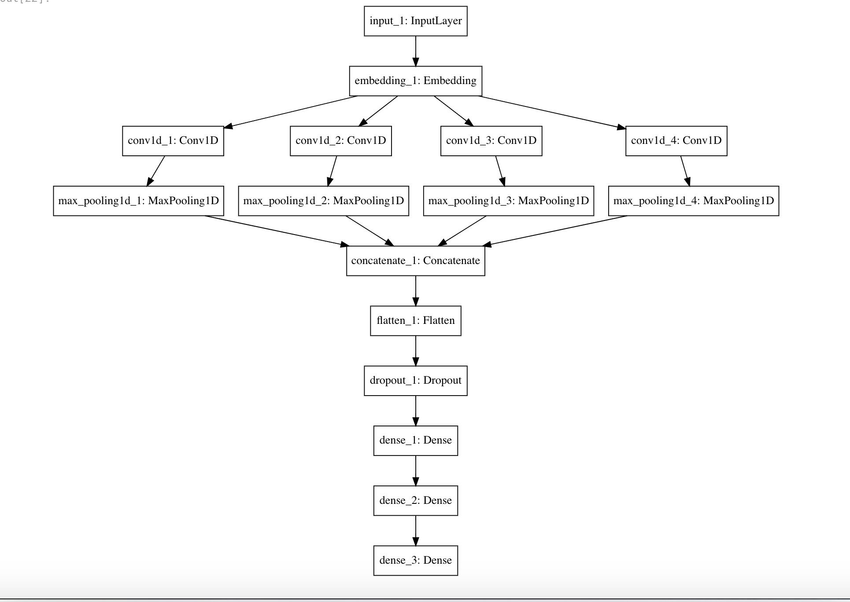
CNN Architecture
The idea in the convolutional neural network was to learn context of words in each review in order to correctly classify the text.
The idea was to vary the size of the kernels and concatenate their outputs, in order to allow the neural network model to detect patterns of multiples sizes of words.
Thus, it allows understanding differences like “very good” as compared to just “very”, “good”.

Slide 7
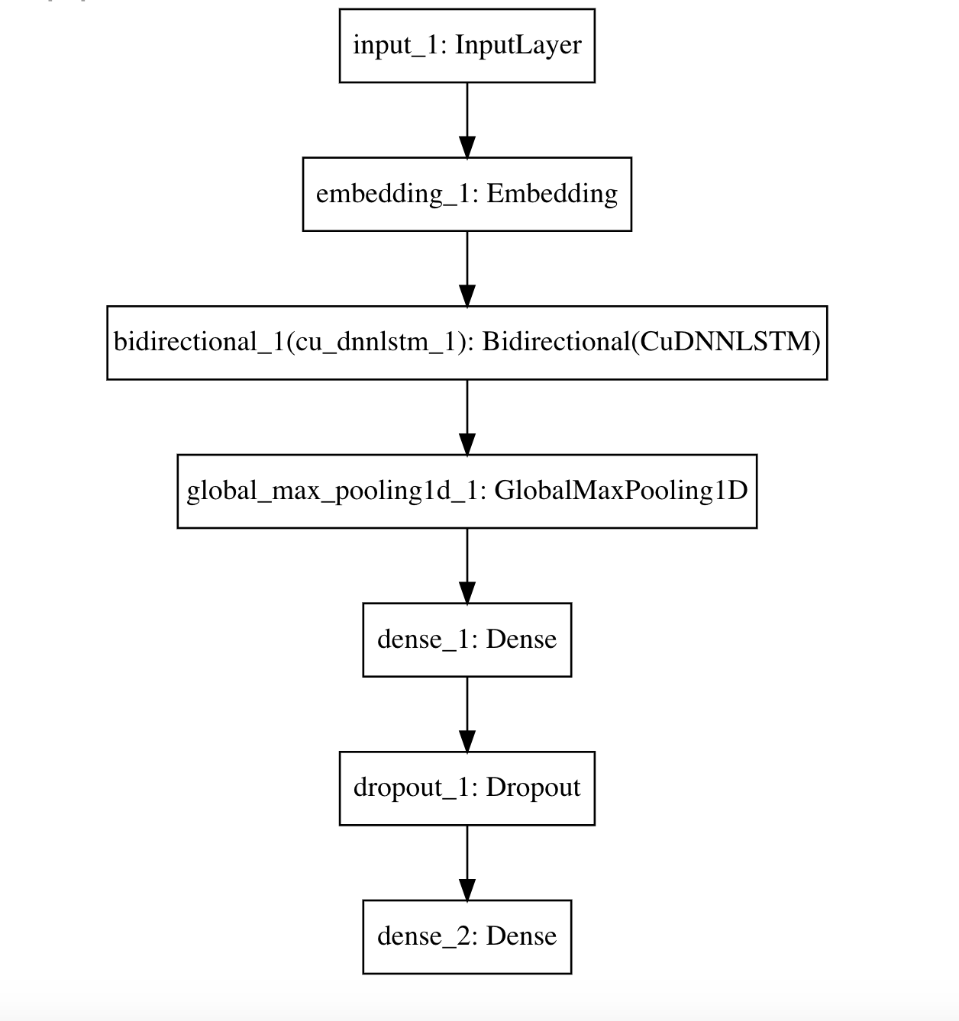
RNN Architecture
The idea in the recurrent neural network is to give attention to words which matter.
Here, words which matter means the network learns which words in the review have more weightage towards the sentiment of the review.
Thus, we have used the LSTM encoder in our neural network which remembers weight of important words and forgets the less important words in each iteration.

Slide 8
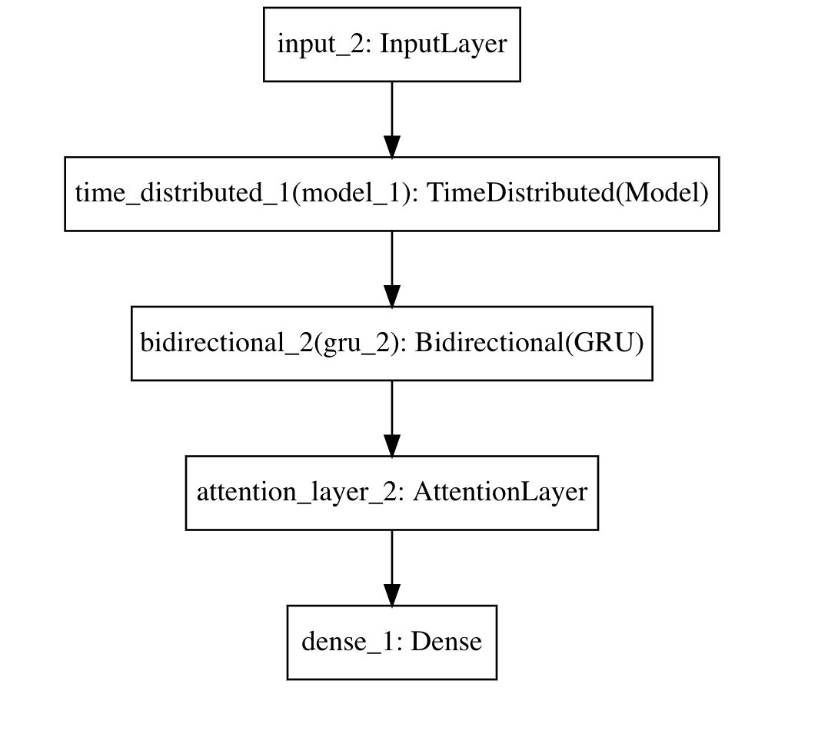
HAN Architecture
The idea in the hierarchical attention neural network was to learn context of the reviews from words followed by a single sentence and then multiple sentences at once.
The attention layer here is used to understand context of a word in different sentences. And then, give due weightage to words which matter more like “amazing” over “better”.
This way, first the context of words, then context from sentences was learnt to classify the review

Slide 9
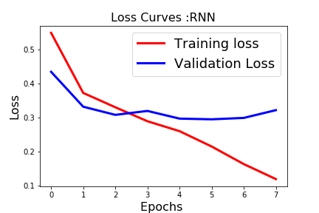
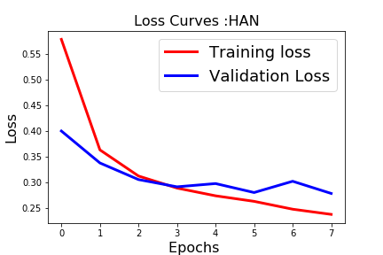
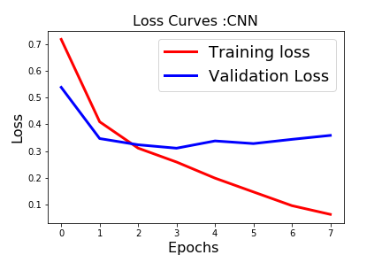
Comparing training of Neural Networks
We trained all our neural networks on GPU. We observed following training times:
CNN - 13 sec/epoch
RNN - 16 sec/epoch
HAN - 420 sec/epoch
From the loss curves that were observed, we see:
The validation loss stabilizes over the training epochs, hence we can conclude that the model train correctly and don’t overfit.
With a smooth training loss, the models achieve accuracy of around 0.9x.

Slide 10
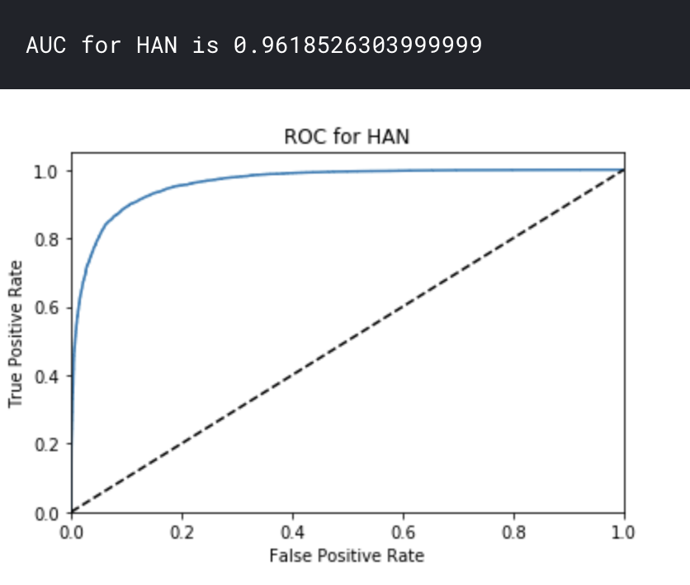
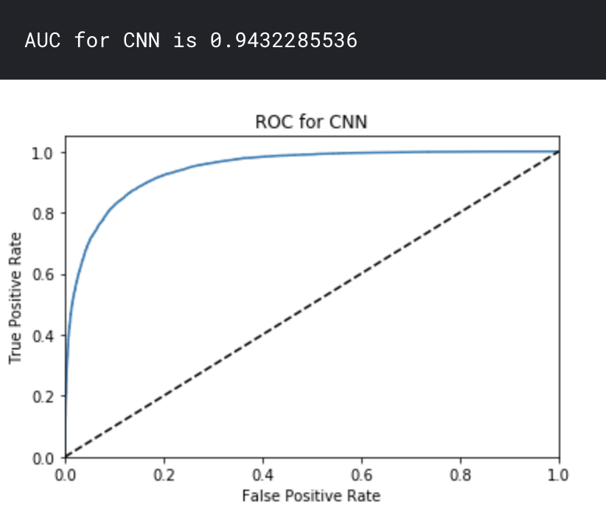
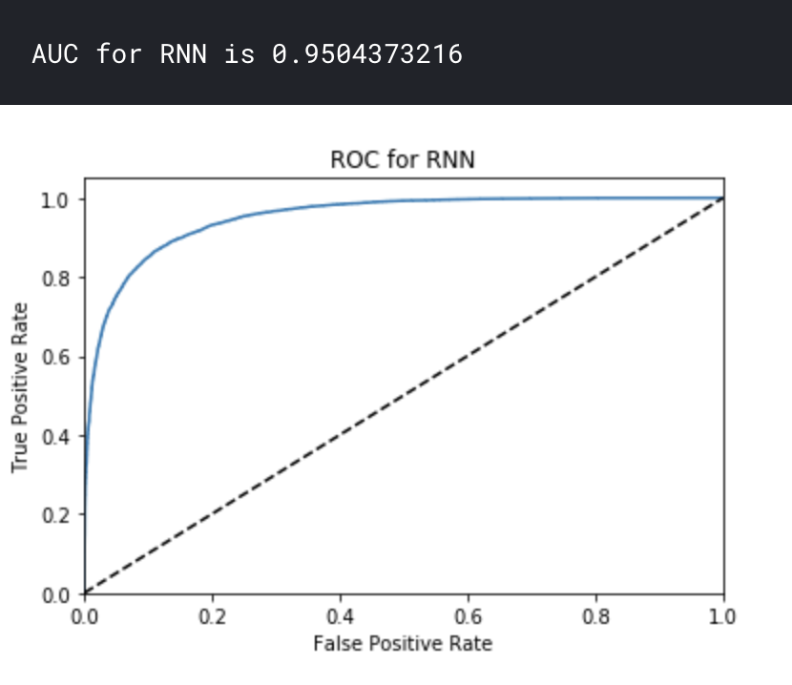
Analyzing Performance of the 3 DNNs
Based on the Area Under the Curves for performance of each neural network on the test data, we can conclude that:
HAN is an architecture which performs better followed by RNN and finally the CNN.
However, in terms of training time, CNN was the fastest followed by RNN and HAN is the slowest.

Slide 11
Conclusions
Based on the performance from the neural network architectures that we have tried,
We found that HAN was better at predicting the labels followed by RNN and CNN.
HAN took the longest to train followed by RNN and CNN.
RNN had the most number of trainable parameters and HAN the least.
When executed on small text corpus (having less sentences) , we observed that HAN could not replicate its performance while RNN and CNN performed considerably on similar lines. Thus, we conclude that HAN requires a larger textual corpus to achieve best results.

Slide 12
References
https://en.wikipedia.org/wiki/Sentiment_analysis
https://nlp.stanford.edu/projects/glove/
https://towardsdatascience.com/sentiment-analysis-with-python-part-1-5ce197074184
https://machinelearningmastery.com/use-word-embedding-layers-deep-learning-keras/
https://www.kaggle.com/iarunava/google-text-classification-notebook
https://github.com/richliao/textClassifier/blob/master/textClassifierHATT.py
https://richliao.github.io/supervised/classification/2016/12/26/textclassifier-HATN/
https://medium.com/jatana/report-on-text-classification-using-cnn-rnn-han-f0e887214d5f https://medium.com/analytics-vidhya/hierarchical-attention-networks-d220318cf87e

